Slide 1
X-Power SECURITY BUSINESS PLAN

Slide 2
CONTENT
X-Power introduction.
Problem.
security
NMS (Network Monitoring Systems)
System integrity

Slide 3

X-power

Slide 4
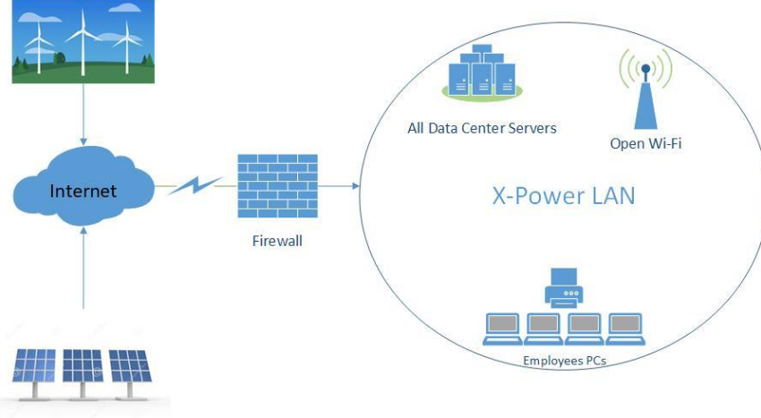
Problem

Slide 5

A PICTURE IS WORTH A THOUSAND WORDS

Slide 6
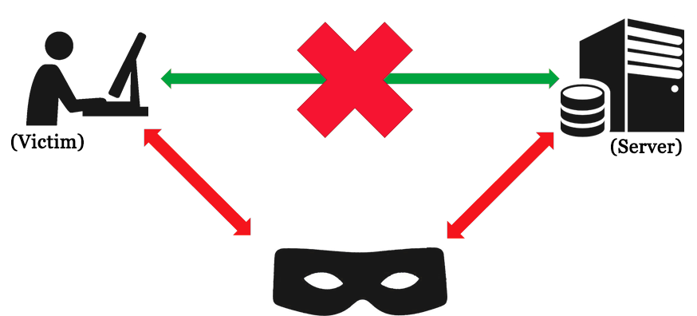

Slide 7

Vulnerability

Slide 8
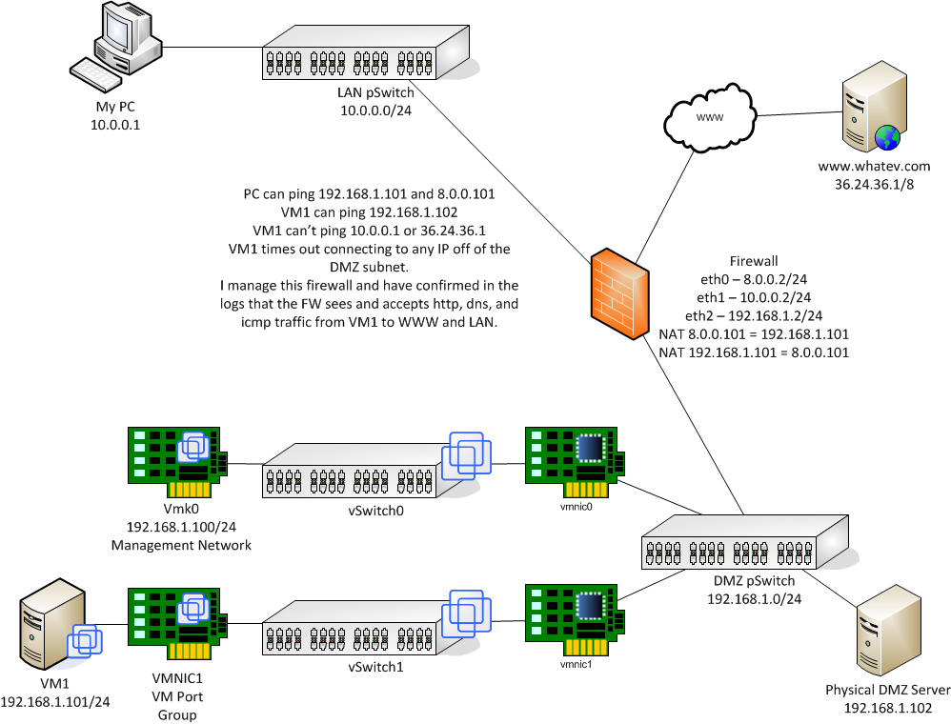

Slide 9
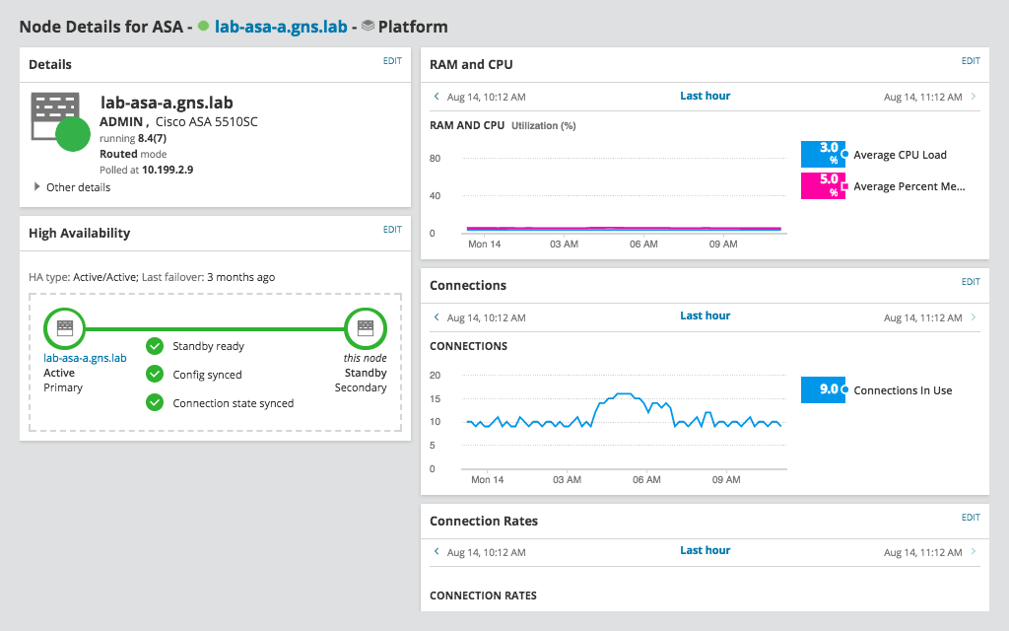
NMS (Network Monitoring System)
SolarWinds
Our platform enables optimal visibility, expertise and design to streamline, streamline and optimize repair time in a variety of settings and environments.

Slide 10
A
Entrance Security
Physical
B
UPS (Uninterruptible Power Supply)
X-Power
C
CCTV
D
Backups
Software
D
VPN
D
VLANs

Slide 11
Thank you
Q/A

